Slide 1
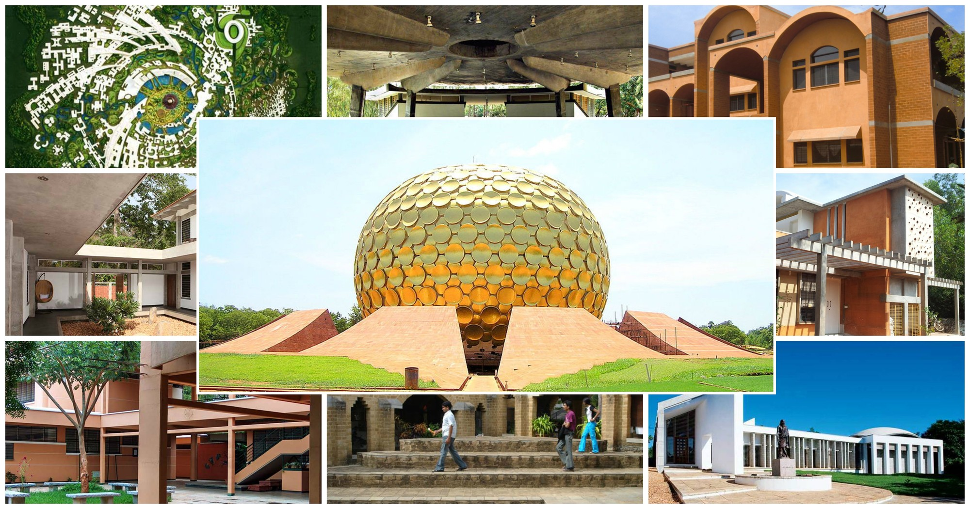
Introduction about Auroville
•By: Ashutosh Shrotriya
•Enrollment No.: 07819011721
•Batch:IIOT B2
•Sub: EVS Presentation
Submitted to : Ms Aditi Singh

Slide 2
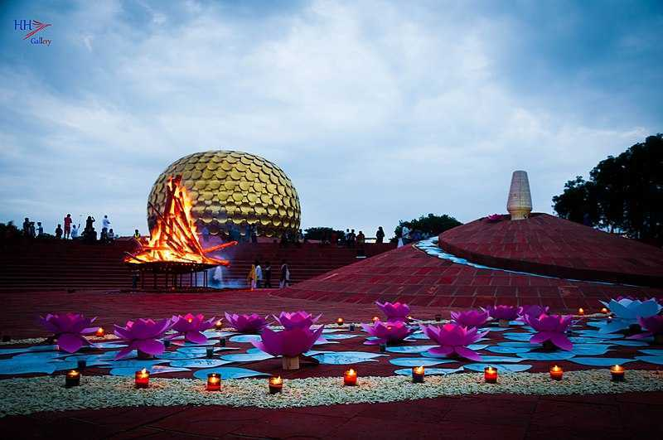
What is Auroville?
• At present, Auroville is a growing community of over 3000 people from 58 nations...
• Auroville wants to be a universal town where men and women of all countries are able to live in peace and progressive harmony above all creeds, all politics and all nationalities. The purpose of Auroville is to realise human unity.

Slide 3

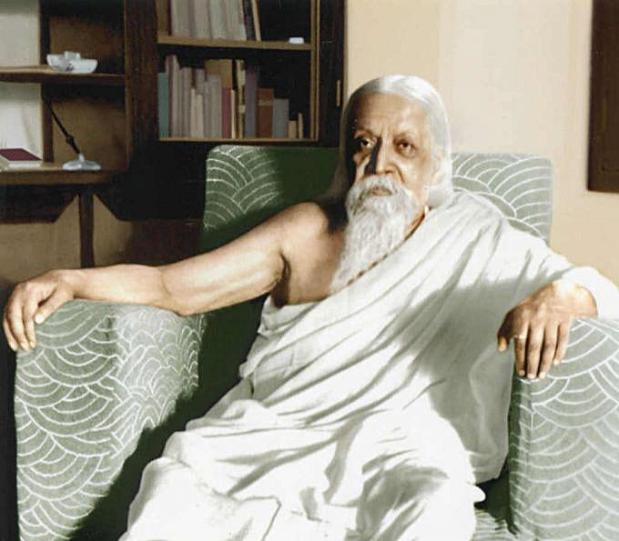
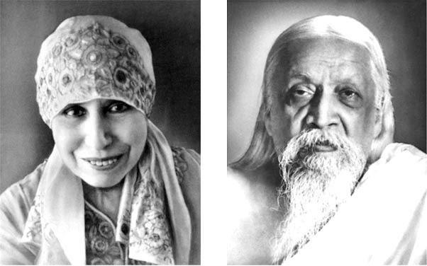
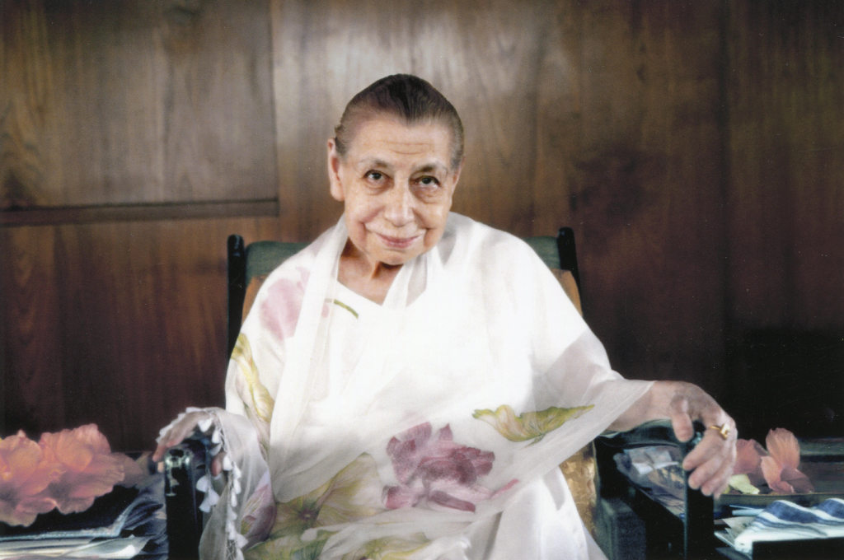
Founders of Auroville
Sri Aurobindo Ghosh
Mirra Alfassa

Slide 4
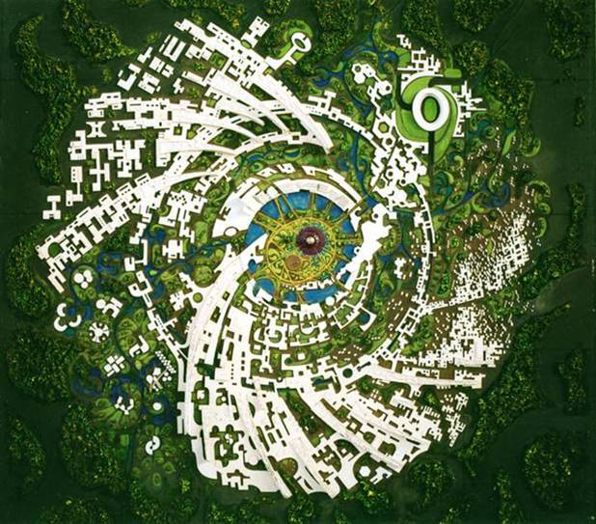
What’s the Vision of the city?
Auroville, sometimes referred to as "The City of Dawn" is conceived for 50,000 inhabitants from around the world. At the centre stands the Matrimandir, the "soul of the city", a place for individual silent concentration, in an oval shaped Peace Area surrounded by a lake. Radiating out beyond the lake are four Zones - the Industrial (north), Cultural (north east), Residential (south/south west) and International (west) - each focusing on an important aspect of the town's life. Surrounding the township will be a Green Belt consisting of forested areas, farms and sanctuaries.

Slide 5
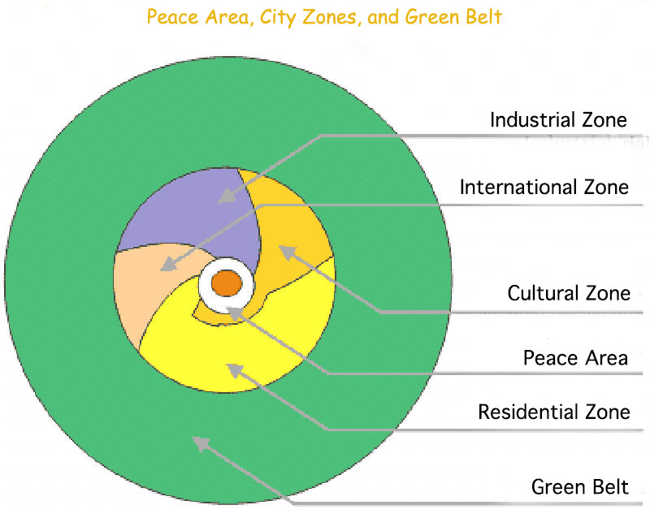
A City of the Future
• One of the most remarkable concepts of Auroville is its master plan, laid out in form of a galaxy - a galaxy in which several 'arms' or Lines of Force seem to unwind from a central region.
• At the centre stands the Matrimandir, the “soul of Auroville”, a place for individual silent concentration.
Radiating out beyond the Matrimandir Gardens are four Zones, each focusing on an important aspect of the township’s life: Industrial (north) Cultural (northeast), Residential (south/south-west) and International (west)
Surrounding the city area is a Green Belt consisting of forested areas, farms and sanctuaries with scattered settlements for those involved in green work.

Slide 6
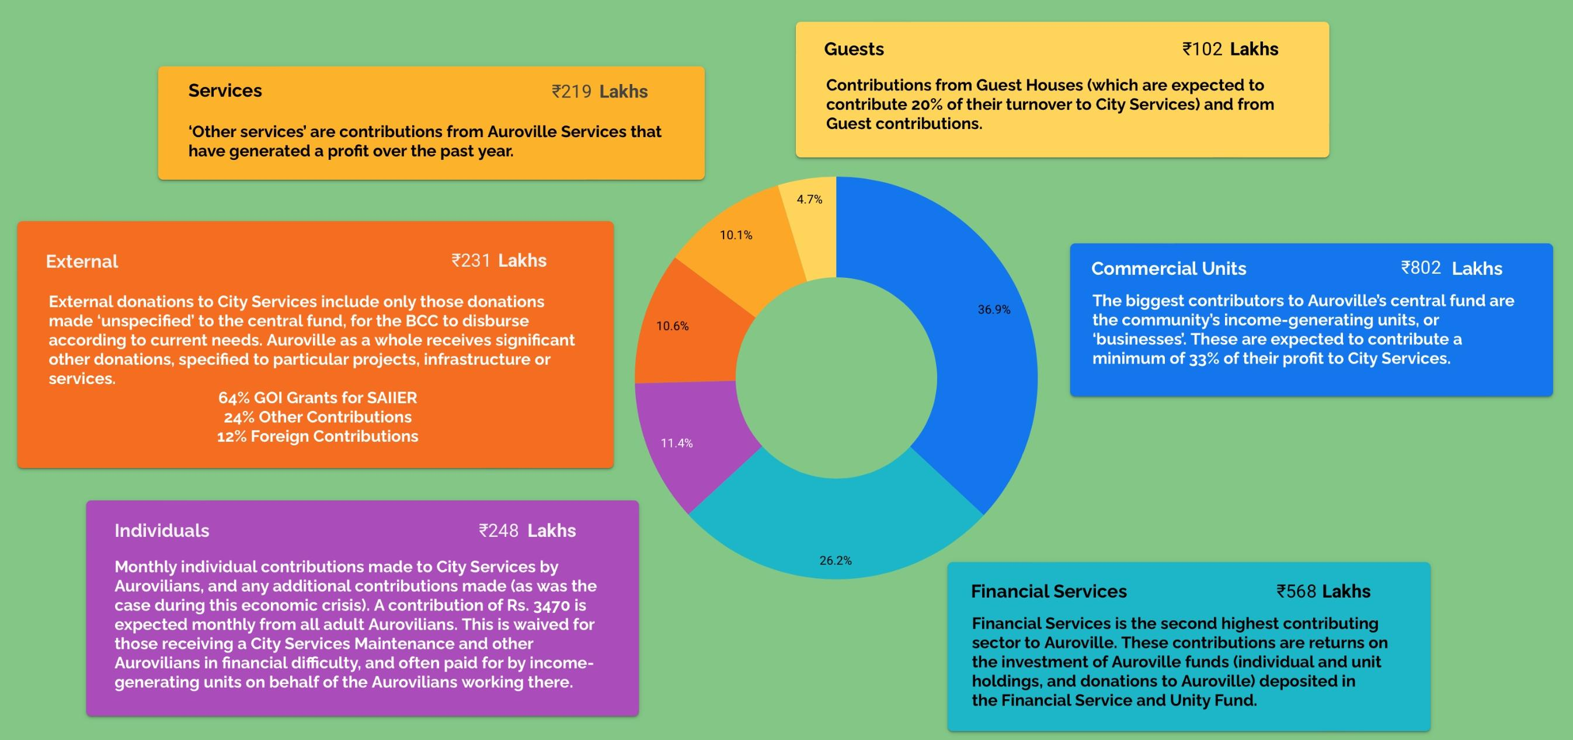
Economic Feasibility

Slide 7
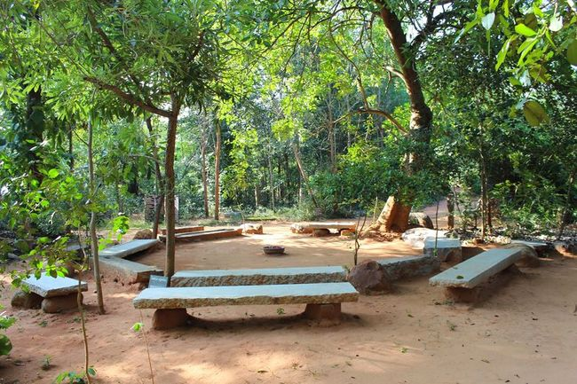
Environmental work
• Afforestation campaign
Auroville's afforestation campaign began in the early 1970's. The first tree nurseries were started in Success and Kottakarai and, with the help of grants from the Point Foundation, the Tamil Fund and friends abroad, large-scale tree planting began.
• Scientific monitoring
In 1982, impressed by the success of the afforestation project, the Department of Environment, Government of India, offered Auroville 11 lakhs of rupees (then around US $ 100,000) over five years to plant trees and scientifically monitor the results so that the most appropriate techniques and species for our situation - which is the situation of many other parts of India - could be identified.

Slide 8


Spirituality at its Finest
Flower Significances
Flowers bring a touch of eternity, joy and beauty which lie beyond the sorrows and cares of the human world. According to The Mother, apart from the colour, fragrance, beauty of form and texture of a flower, there is something more - an aspiration, an emanation, an aspect, a psychic giving, wordless prayers of Nature and a progress in the evolution of the Earth. All these attributes together form the spiritual significance of a flower. A conscious and intimate relationship with flowers can give an experience of communion with the Divine and awakens the true consiousness in us. The Mother, over time, has given spiritual names to nearly nine hundred flowers revealing their deepest aspiration.
The Mother has named the Hawain Hibiscus as the flower of Auroville

Slide 9
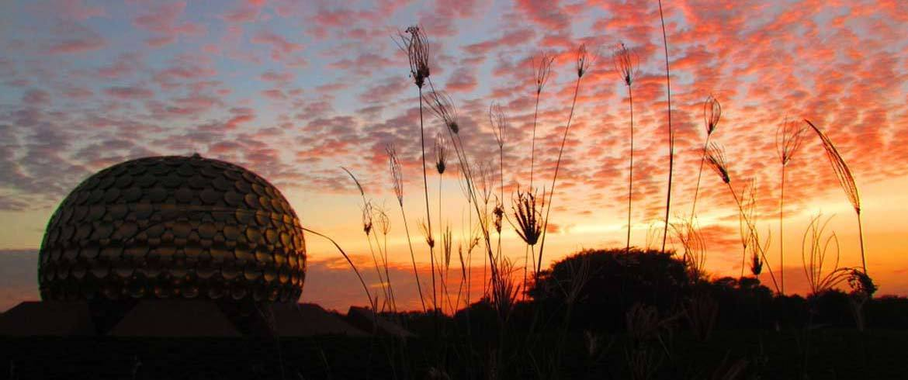
Upcoming presentations on Auroville
Next up : Additional Human values that are embodied in Auroville
by-> Ashutosh Kumar Singh
Enrollment no.-> 07319011721
Later : Challenges being faced by Auroville
by ->Nitin Sharma
Enrollement no.->08419011721

Slide 10
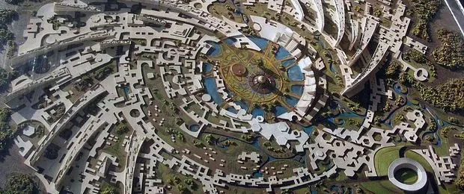
1.The purpose of Auroville is to realize human unity.
"Auroville is meant to be a universal town where men and women of all countries are able to live in peace and progressive harmony, above all creed, all politics and all nationalities. The purpose of Auroville is to realize human unity."
It was founded on 28th February, 1968, by Mirra Alfassa (known as "The Mother") as a project of the Sri Aurobindo Society. Mirra Alfassa was the spiritual collaborator of Sri Aurobindo, who held the notion that "man is a transitional being". It was designed by Roger Anger.

Slide 11
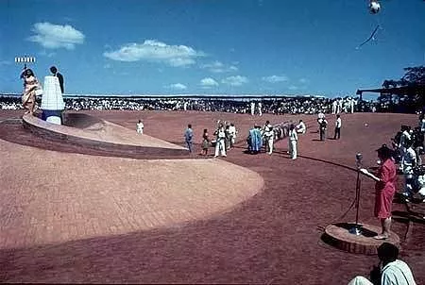
2.Universal Township
Mother believed that the "universal township" of Auroville would contribute decisively to the Indian renaissance.
She expected that Auroville would "contribute significantly in the progress of humanity towards its splendid future by bringing together people of goodwill and aspiration for a better world."

Slide 12
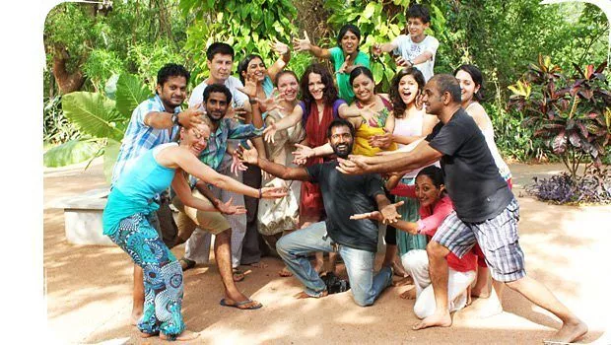
3.Auroville belongs to nobody in particular
"Auroville belongs to nobody in particular. Auroville belongs to humanity as a whole. But to live in Auroville, one must be the willing servitor of the Divine Consciousness."
People who inhabit Auroville come from around 50 nations, hailing from all age groups, social classes, cultures and backgrounds. In short, Auroville represents humanity as a whole. Its population currently stands at close to 2,400 people.

Slide 13
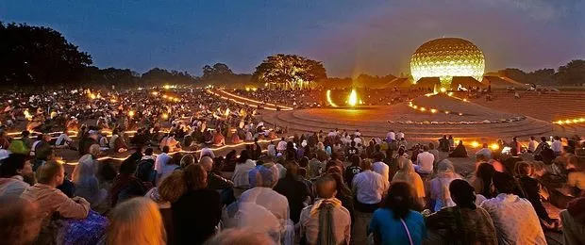
4.There is no concept of religion in Auroville!
Auroville believes in the service of truth, beyond religious conviction. There is a temple at the centre of the township called "Matrimandir". It is of spiritual significance for those who practice Integral yoga and doesn't belong to any particular religion or sect.

Slide 14
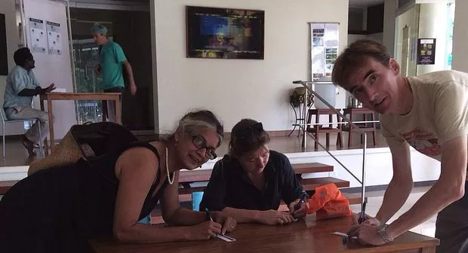
5. There also no concept of politics
Auroville runs without a hierarchical order. It is controlled by an assembly that comprises of every adult resident. Imagine a township being ran by an assembly of 900-odd members, hailing from different cultures, who at times do not even understand one another! Despite the community's internal struggles, it flourishes almost as an independent nation!

Slide 15
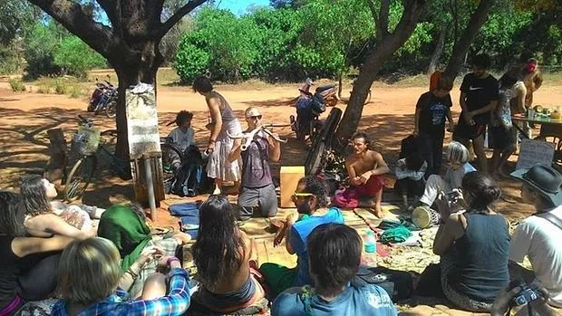
6.There is no concept of money either!
"There won't be any exchange of money in Auroville. It is only with the outside world that Auroville will have money relations. Money will be no more the Sovereign Lord; individual value will have a greater importance than the value due to material wealth and social position." - Mother
There is a concept of Aurocard in this town.

Slide 16
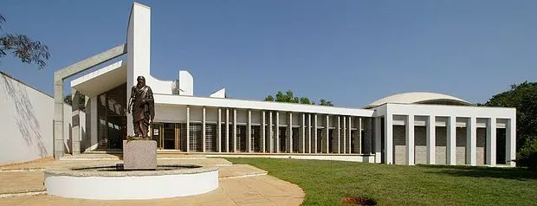
7. Auroville is self-reliant in the truest sense of the word.
Auroville has its own architecture and town planning bureau. It has archival facilities, research institutions, an auditorium, 40-odd industries, restaurants, farms, guesthouses etc! It even has a high density of computers, a dedicated e-mail network (auronet) for the residents.

Slide 17


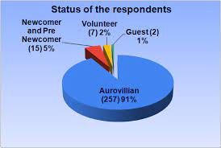
Financial matters
The objective is to accommodate 50,000 inhabitants. To make this a reality, the residents of Auroville have asked the Indian government for €120 million in a bid to rejuvenate this dormant utopia. Only around 100 people settle in Auroville each year, in search of spirituality and ecological values.

Slide 18

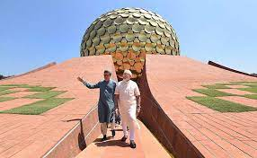
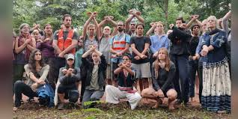
Government matter
In 1980, the Government of India passed the Auroville Emergency Provision Act 1980, under which it took over the city's management.
The Act stipulated the vesting of all movable and immovable assets of the city in a foundation, known as Auroville Foundation
three-tier governing system: the Governing Board; the Residents' Assembly and the Auroville International Advisory Council.
In order to protect children in the Auroville area from child abuse

Slide 19


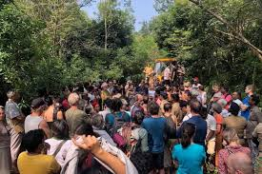
SECURITY ISSUE
On December 4th, 2021, local police, joined by a group of outsiders, began demolishing the Auroville Youth Centre – uprooting the surrounding trees with the help of JCBs.
Foreign residents of Auroville, including many early settlers, are facing issues with visa extensions, and with an FIR having been filed against 6 residents, 5 of whom are foreign nationals, for obstructing allegedly illegal entry to confidential documents

Slide 20




CONCLUSION
STRENGTH
The city planning of Auroville is based onprinciple of sustainability.
OPPORTUNITIES
To create abundance for the growth of Auroville.
WEAKNESS
Lack of infrastructure, especially power and water supply, were mentioned in two cases. The problem is lack of planning efforts in centralized infrastructure.
At present Auroville is highly decentralized communities and units are scattered all over 2400 acres, so it is difficult to provide a centralized infrastructure.
Red Soil with good amount of iron oxide which makes a good building material
Site is surrounded by green belt.
To built and strengthen a shared economy.
To provide a healthy and sustainable environment for the development of people from Auroville, the bioregion, India and the World.
To develop while maintaining harmony with nature a

Slide 21

